Slide 1

Analysis of Bank marketing Dataset
Classification method
Group - 6

Slide 2
01
Data Preprocessing
02
Exploratory data analysis
CONTENTS
03
Algorithms
04
Summary and Appendix

Slide 3
D A T A
ABOUT THE DATA
The data is related with direct marketing campaigns of a Portuguese banking institution. The task here is to build a multivariate classification model to predict “y”-(has the client subscribed a term deposit?)
OBJECTIVE
Bank marketing is the practice of attracting and acquiring new customers through traditional media and digital media strategies. The use of these media strategies helps determine what kind of customer is attracted to a certain institutions.The marketing campaigns were based on phone calls. Often, more than one contact to the same client was required, in order to access if the product (bank term deposit) would be ('yes') or not ('no') subscribed.
PATH
implementing multiple machine learning models to fit the best model for the dataset

Slide 4
y | has the client subscribed a term deposit? (binary: "yes","no")
age | numeric
job | type of job
marital | marital status
education | categorical: "unknown","secondary","primary","tertiary"
default | has credit in default?
balance | average yearly balance, in euros
housing | has housing loan?
loan | has personal loan?
contact | contact communication type
day | last contact day of the month
month | last contact month of year
duration | last contact duration, in seconds
campaign | number of contacts performed during this campaign and for this client
pdays | number of days that passed by after the client was last contacted from a previous campaign
previous | number of contacts performed before this campaign and for this client
poutcome | outcome of the previous marketing campaign
DATA INTRODUCTION
The data consist of 17 columns and 4521 observations. from may 2007 to nov 2010
VARIABLES

Slide 5
Data Preprocessing
01
Data preprocessing is an important step in the data mining process. It refers to the cleaning, transforming, and integrating of data in order to make it ready for analysis.

Slide 6

DROPPED COLUMNS
Missing values
DAY
no missing values observed
does not provide any significant data
MONTH
does not provide any significant data

Slide 7
EDA
02
Exploratory data analysis (EDA) is used by data scientists to analyze and investigate data sets and summarize their main characteristics, often employing data visualization methods.

Slide 8
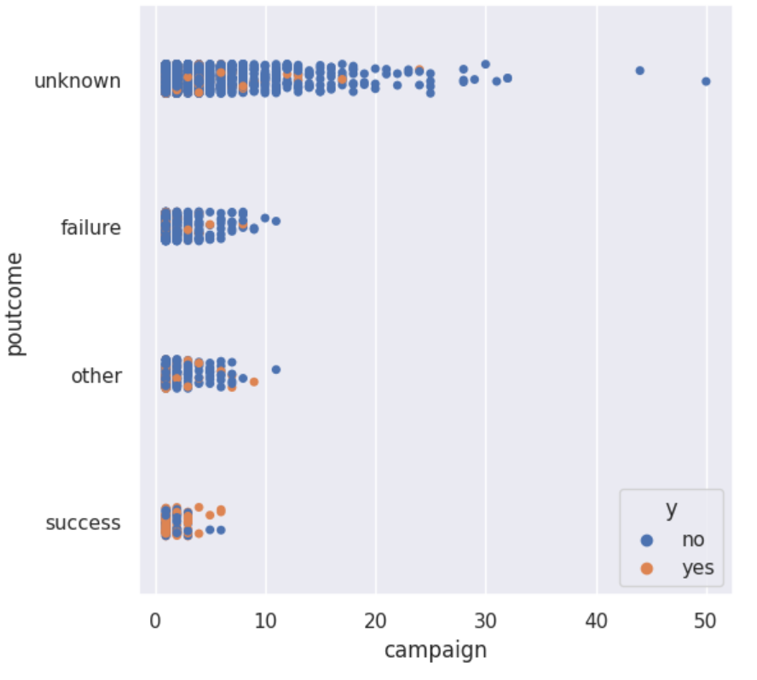
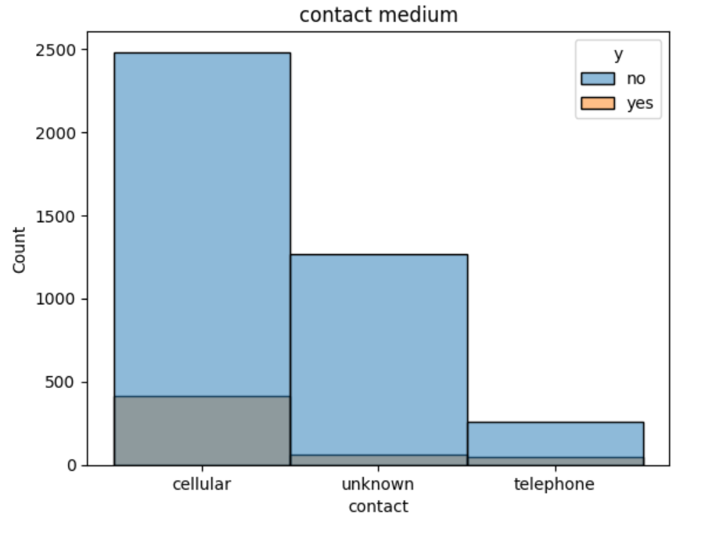
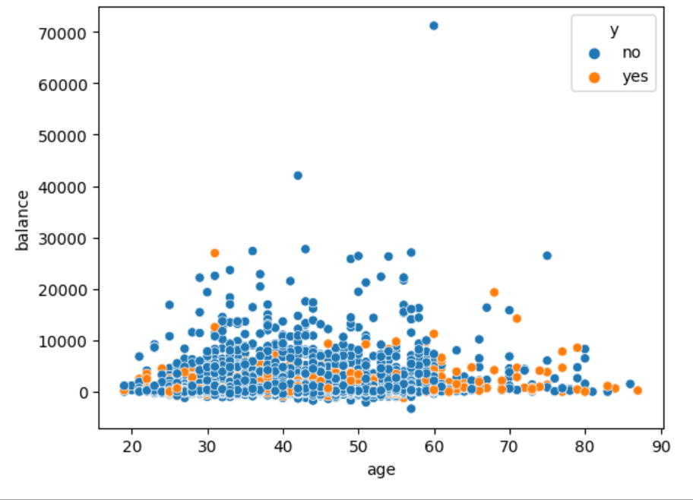
Histplot of contact medium shows an effect of y
Scatter plot of age shows high correlation with y
Stripplot of poutcomes and campaign with y shows high correlation with the poutcomes

Slide 9
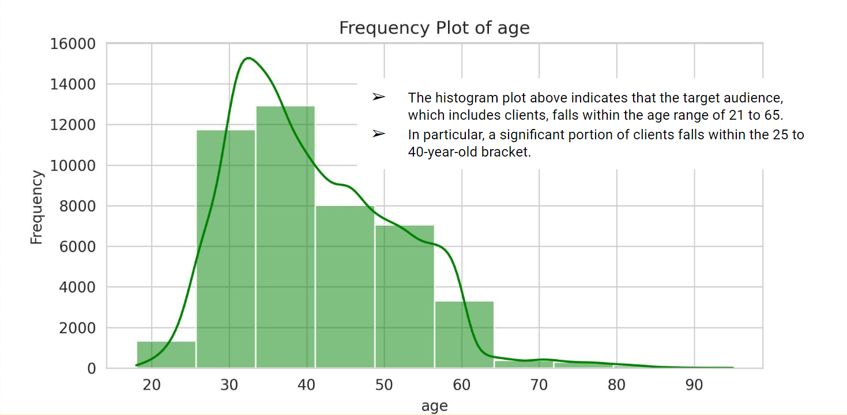
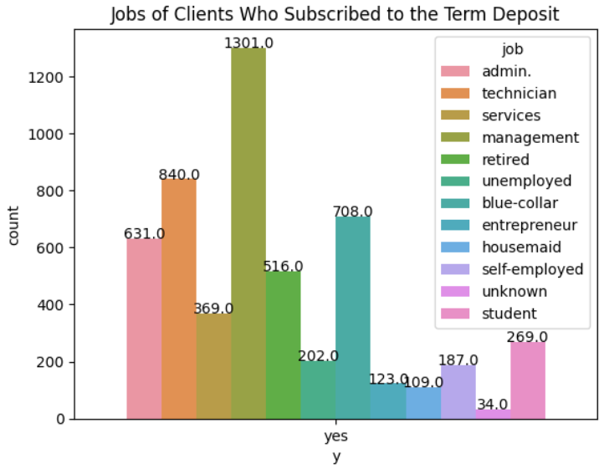
The group of clients with management positions has the highest subscription rate to the term deposit, followed by those in technician and blue-collar jobs.

Slide 10
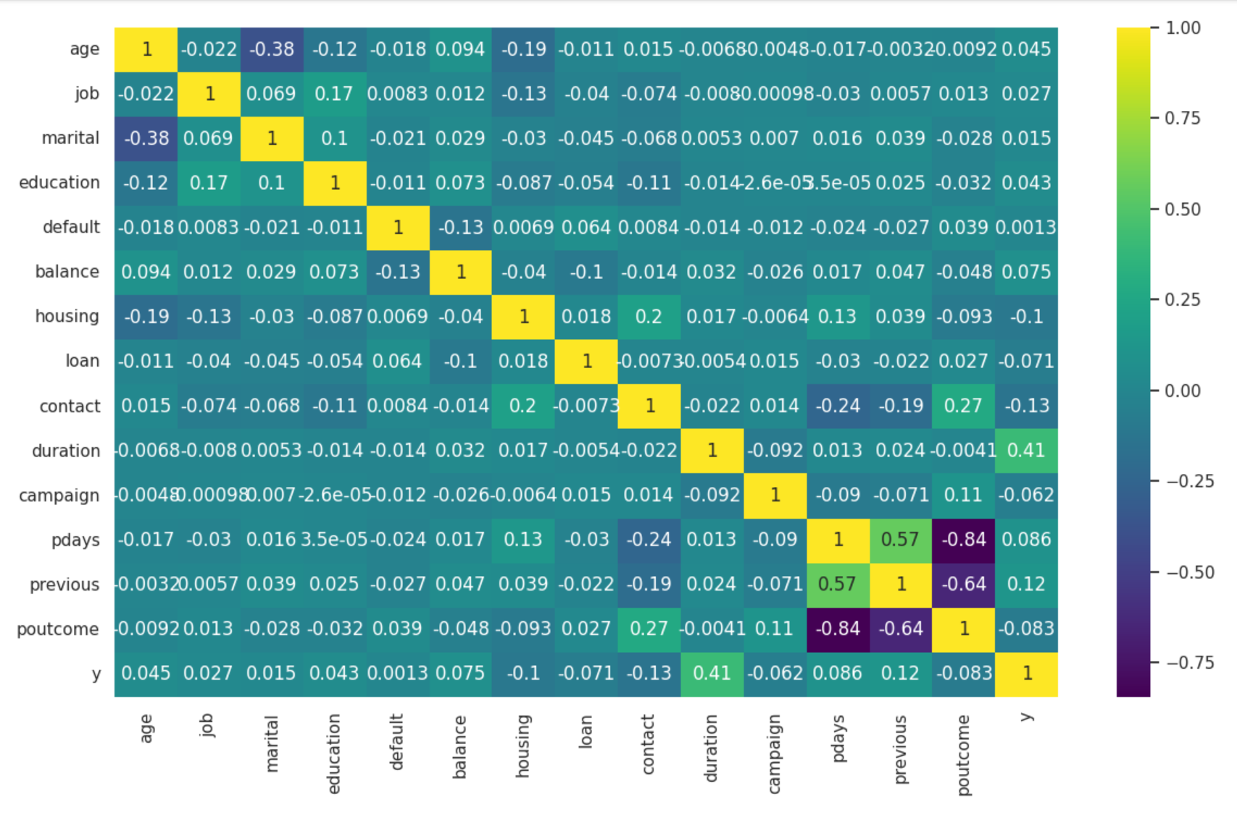
HEATMAP
1. duration,previous are comparatively high positive correlation with the target y
2.housing and contact are comparatively have high negetive correlation with the target y

Slide 11
ALGORITHMS
03
A machine learning algorithm is the method by which the AI system conducts its task, generally predicting output values from given input data.

Slide 12
LOGISTIC REGRESSION
Logistic regression estimates the probability of an event occurring, such as voted or didn't vote, based on a given dataset of independent variables.
0.901
0.897
0.896
0.892
0.895
scores
20-80
25-75
10-90
35-65
30-70
TRAIN TEST RATIO

Slide 13
DECISION TREE
100
0.886
90
0.885
80
0.882
70
0.882
60
0.878
50
Decision tree classifiers are decision trees used for classification. As any other classifier, the decision tree classifiers use values of attributes/features of the data to make a class label (discrete) prediction.
40
SCORES
30
20
10
0
70-30
80-20
90-10
65-35
75-25
TRAIN TEST RATIO

Slide 14
RANDOM FOREST
0.887
0.878
0.891
0.890
90-10
80-20
25-75
70-30
TRAIN TEST SPLIT

Slide 15
KNN
0.887
0.885
0.885
0.877
90-10
80-20
25-75
70-30
TRAIN TEST SPLIT

Slide 16
SVM
A support vector machine (SVM) is a type of supervised learning algorithm used in machine learning to solve classification and regression tasks; SVMs are particularly good at solving binary classification problems, which require classifying the elements of a data set into two groups.
ACCURACY SCORE = 0.885

Slide 17

BOOSTING
Boosting converts a system of weak learners into a single strong learning system. For example, to identify the cat image, it combines a weak learner that guesses for pointy ears and another learner that guesses for cat-shaped eyes.
01
ADA BOOSTING
AdaBoost, short for Adaptive Boosting, is an ensemble machine learning algorithm that can be used in a wide variety of classification and regression tasks.
02
XGBOOST
XGBoost is a boosting algorithm that uses bagging, which trains multiple decision trees and then combines the results.

Slide 18
ADA BOOSTING
TRAIN TEST SPLIT | SCORE
90-10 | 0.907
80-20 | 0.908
75-25 | 0.908
70-30 | 0.912
65-35 | 0.910
D
A
A
B

Slide 19
XGBOOST
TRAIN TEST SPLIT | SCORE
90-10 | 0.891
80-20 | 0.891
75-25 | 0.894
70-30 | 0.893
65-35 | 0.893
G
B
X
T

Slide 20
CLASSIFICATION MODEL | ACCURACY SCORE
LOGISTIC REGRESSION | 0.901
DECISION TREE | 0.886
RANDOM FOREST | 0.891
KNN | 0.887
SVM | 0.885
ADA BOOSTING | 0.912
XGBOOST | 0.894
COMPARISON OF IMPLEMENTED MODELS

Slide 21
SUMMARY AND RECOMMENDATIONS
04
.

Slide 22
SUMMARY
1.
2.
for the bank marketing dataset, we performed different types of machine learning algorithms
from the eda showed clearly which features that are more and less correlated to target
01
02
03
04
3.
4.
the best algorithm is ADA BOOSTING with the score of 0.912
so, we conclude that ADA BOOSTING algorithm is considered the best model

Slide 23

RECOMMENDATIONS
1.The features like age,martial status,poutcomes,campaign and job are key variables.
2.The features like poutcomes , pdays ,pervious and campiagn and are all interconnected.

Slide 24
Analysis of Bank marketing Dataset
Classification method
Group - 6

Slide 25
01
Data Preprocessing
02
Exploratory data analysis
CONTENTS
03
Algorithms
04
Summary and Recommendations

Slide 26
D A T A
ABOUT THE DATA
The data is related with direct marketing campaigns of a Portuguese banking institution. The task here is to build a multivariate classification model to predict “y”-(has the client subscribed a term deposit?)
OBJECTIVE
Bank marketing is the practice of attracting and acquiring new customers through traditional media and digital media strategies. The use of these media strategies helps determine what kind of customer is attracted to a certain institutions.The marketing campaigns were based on phone calls. Often, more than one contact to the same client was required, in order to access if the product (bank term deposit) would be ('yes') or not ('no') subscribed.
PATH
Implementing multipe machine learning models to fit the best model for the dataset

Slide 27
y | has the client subscribed a term deposit? (binary: "yes","no")
age | numeric
job | type of job
marital | marital status
education | categorical: "unknown","secondary","primary","tertiary"
default | has credit in default
balance | average yearly balance, in euros
housing | has housing loan
loan | has personal loan
contact | contact communication type
day | last contact day of the month
month | last contact month of year
duration | last contact duration, in seconds
campaign | number of contacts performed during this campaign and for this client
pdays | number of days that passed by after the client was last contacted from a previous campaign
previous | number of contacts performed before this campaign and for this client
poutcome | outcome of the previous marketing campaign
DATA INTRODUCTION
The data consist of 17 columns and 4521 observations. from may 2007 to nov 2010
VARIABLES

Slide 28
Data Preprocessing
01
Data preprocessing is an important step in the data mining process. It refers to the cleaning, transforming, and integrating of data in order to make it ready for analysis.

Slide 29
DROPPED COLUMNS
Missing values
DAY
no missing values observed
does not provide any significant data
MONTH
does not provide any significant data

Slide 30
EDA
02
Exploratory data analysis (EDA) is used by data scientists to analyze and investigate data sets and summarize their main characteristics, often employing data visualization methods.

Slide 31
Histplot of contact medium shows that clients with cellular medium of contact are more likely to get term deposit.
Scatter plot shows that clients from age 55 - 80 tend to get term deposit more than other age groups.
Stripplot shows that when the outcome of campaign is a success there is a high chance of the client getting the term deposit.

Slide 32
The group of clients with management positions has the highest subscription rate to the term deposit, followed by those in technician and blue-collar jobs.

Slide 33
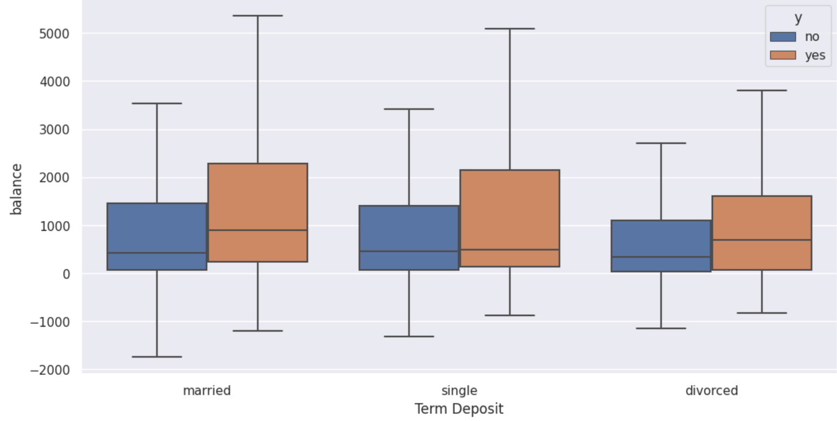
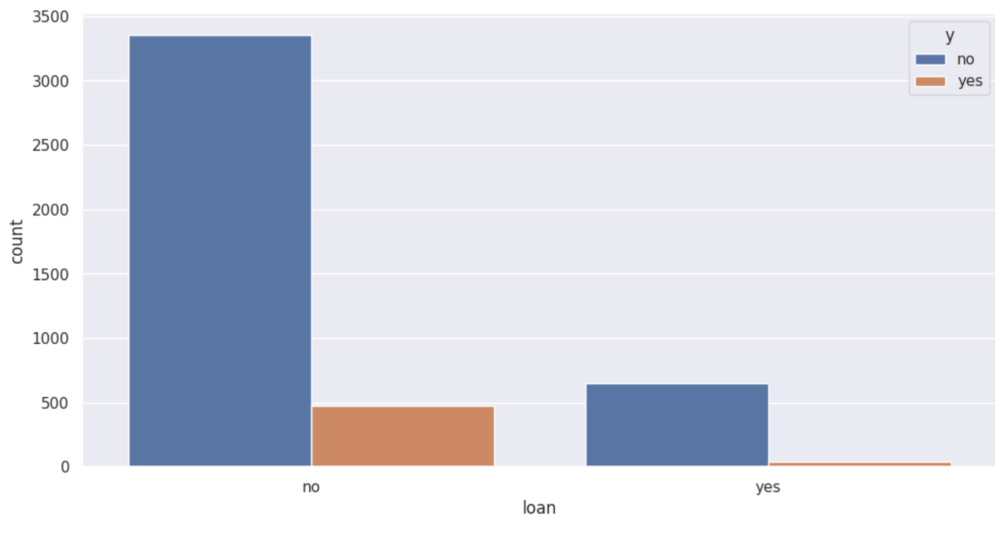
THIS BOXPLOT SHOWS THAT MAJORITY OF CLIENTS BALANCE B/W 0 TO 2000 EUROS AND CLIENTS WITH AN HIGHER BALANCES TENDS TO GET TERM DEPOSIT
THE COUNTPLOT SHOWS THAT CLIENTS HAVING LOAN FROM THE BANK ARE NOT GETTING TERM DEPOSIT.

Slide 34
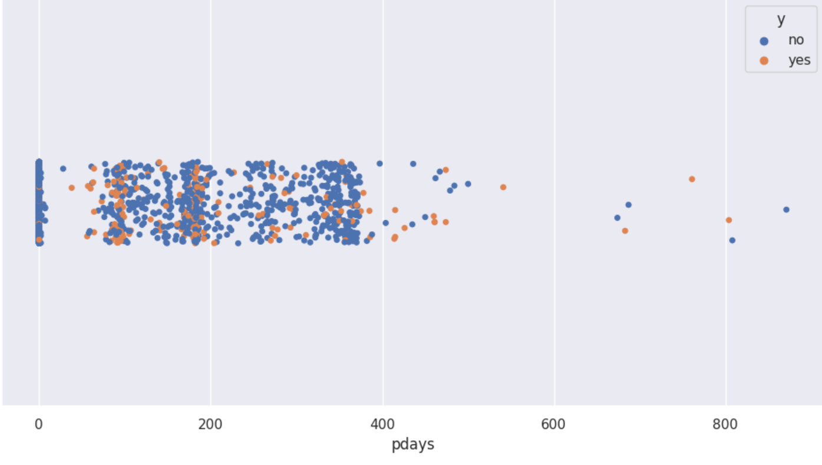
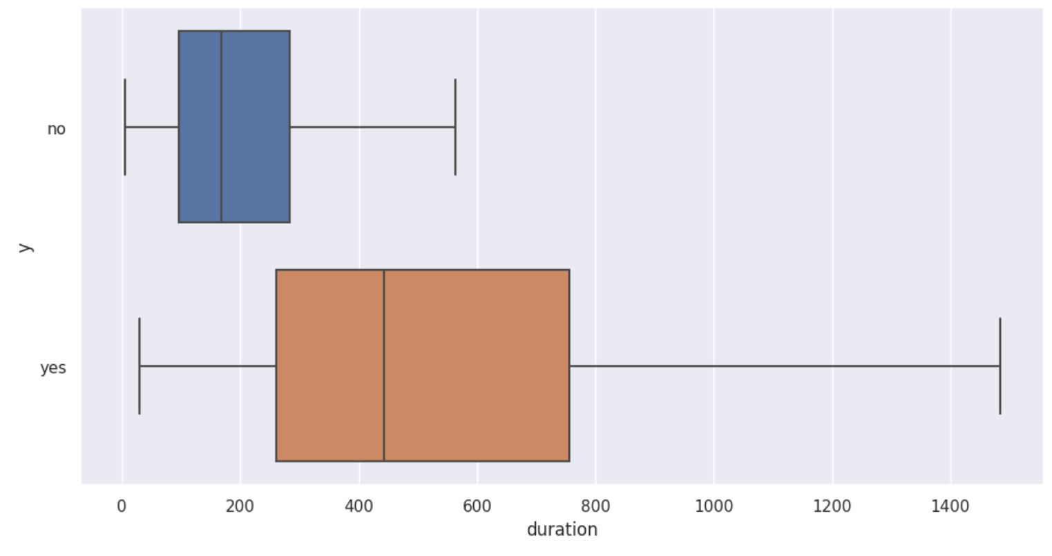
Number of days that passed by after the client was last contacted from a previous campaign (PDAYS) is more successful at 100 - 200 days
Last contact duration, in seconds
The duration of the call is longer in the client who has subscribed a term deposit.

Slide 35
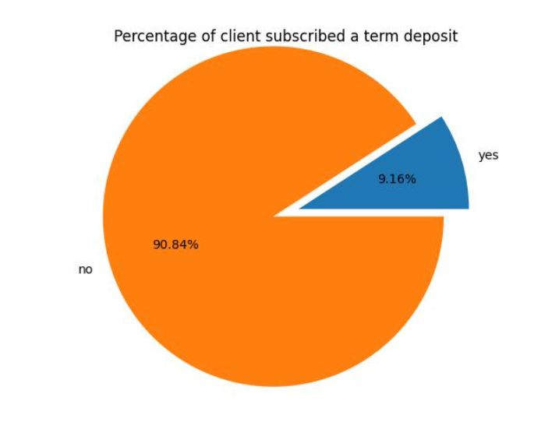
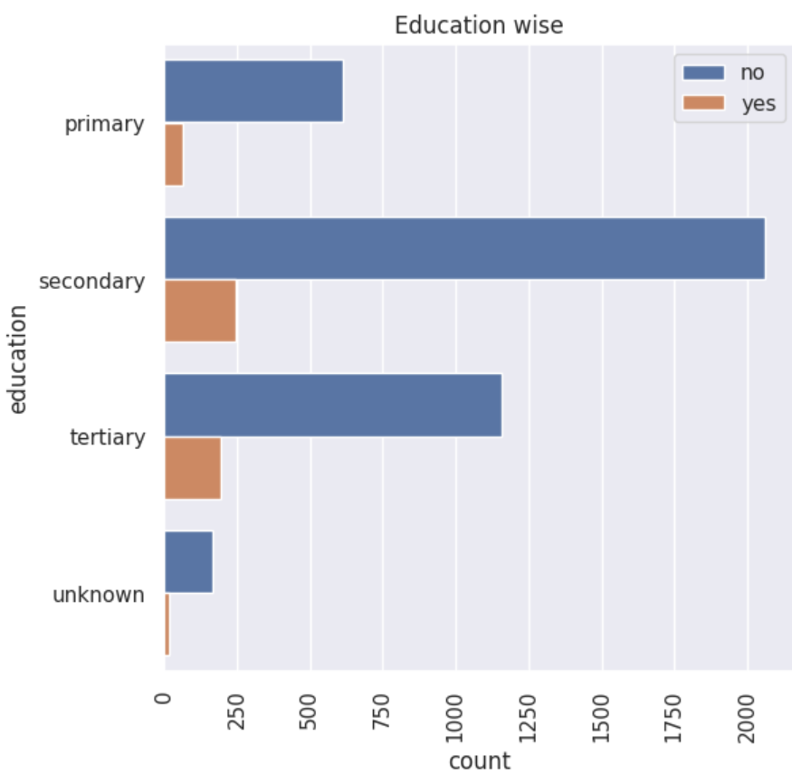
PIE CHART
COUNTPLOT
COUNTPLOT
This pie chart illustrates that a relatively small portion, approximately 9.16%, of clients have subscribed to a term deposit, while the remaining 90.84% of clients have not subscribed to such a deposit.
The clients who have subscribed to the term deposit primarily hold secondary and tertiary-level education.
The countplot show that the clients having a housing loan are less likely to get a term deposit

Slide 36
HEATMAP
1.Duration,previous are comparatively high positive correlation with the target y
2.Housing and contact are comparatively have high negetive correlation with the target y

Slide 37
ALGORITHMS
03
A machine learning algorithm is the method by which the AI system conducts its task, generally predicting output values from given input data.

Slide 38
LOGISTIC REGRESSION
Logistic regression estimates the probability of an event occurring, such as voted or didn't vote, based on a given dataset of independent variables.
0.901
0.897
0.896
0.892
0.895
Accuracy
scores
20-80
25-75
10-90
35-65
30-70
TRAIN TEST RATIO

Slide 39
DECISION TREE
100
0.886
90
0.885
80
0.882
70
0.882
60
0.878
50
Decision tree classifiers are decision trees used for classification. As any other classifier, the decision tree classifiers use values of attributes/features of the data to make a class label (discrete) prediction.
40
SCORES
30
20
10
0
70-30
80-20
90-10
65-35
75-25
TRAIN TEST RATIO

Slide 40
RANDOM FOREST
0.887
0.878
0.891
0.890
90-10
80-20
25-75
70-30
TRAIN TEST SPLIT

Slide 41
KNN
0.887
0.885
0.885
0.877
90-10
80-20
25-75
70-30
TRAIN TEST SPLIT

Slide 42
SVM
A support vector machine (SVM) is a type of supervised learning algorithm used in machine learning to solve classification and regression tasks; SVMs are particularly good at solving binary classification problems, which require classifying the elements of a data set into two groups.
ACCURACY SCORE = 0.885

Slide 43
BOOSTING
Boosting converts a system of weak learners into a single strong learning system. For example, to identify the cat image, it combines a weak learner that guesses for pointy ears and another learner that guesses for cat-shaped eyes.
01
ADA BOOSTING
AdaBoost, short for Adaptive Boosting, is an ensemble machine learning algorithm that can be used in a wide variety of classification and regression tasks.
02
XGBOOST
XGBoost is a boosting algorithm that uses bagging, which trains multiple decision trees and then combines the results.

Slide 44
ADA BOOSTING
TRAIN TEST SPLIT | SCORE
90-10 | 0.907
80-20 | 0.908
75-25 | 0.908
70-30 | 0.912
65-35 | 0.910
D
A
A
B

Slide 45
XGBOOST
TRAIN TEST SPLIT | SCORE
90-10 | 0.891
80-20 | 0.891
75-25 | 0.894
70-30 | 0.893
65-35 | 0.893
G
B
X
T

Slide 46
CLASSIFICATION MODEL | ACCURACY SCORE
LOGISTIC REGRESSION | 0.901
DECISION TREE | 0.886
RANDOM FOREST | 0.891
KNN | 0.887
SVM | 0.885
ADA BOOSTING | 0.912
XGBOOST | 0.894
COMPARISION OF IMPLEMENTED MODELS

Slide 47
SUMMARY AND RECOMMENDATIONS
04
.

Slide 48
SUMMARY
1.
2.
For the bank marketing dataset, we performed different types of machine learning algorithms.
From the eda it showed clearly which features that are more and less correlated to target.
01
02
03
04
3.
4.
The best algorithm is ADA BOOSTING with the score of 0.912 with the split 70-30.
So, we conclude that ADA BOOSTING algorithm is considered the best model.

Slide 49
RECOMMENDATIONS
1.The features like age,loan,poutcomes,campaign and job are key variables.
2.The features like poutcomes,pdays,pervious and campiagn and are all interconnected.
3.After further accounting the effects of other variables duration of the call and age are the basic predictor for getting the term deposit

Slide 50
THANKS
PRESENTED BY
SARA NAAZNEEN
MADIRAI
TAFADZWA
KEERTHI

Slide 51
THANKS
PRESENTED BY
SARA NAAZNEEN
MADIRAI
TAFADZWA
KEERTHI

